Slide 1

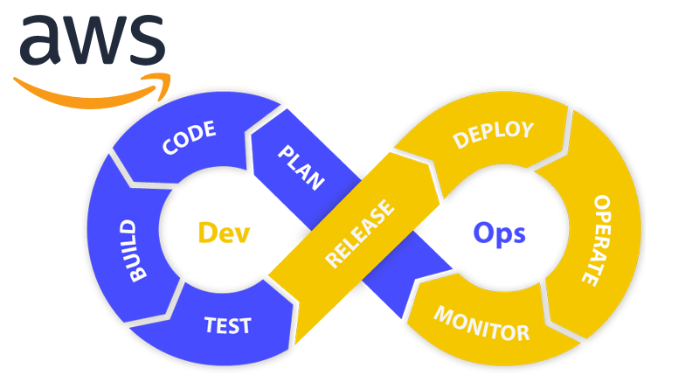
Major Project - AWS
CI/CD Pipeline
Presented By:-
Saty Narayan
Presented To:-Nitin Sir

Slide 2
INDEX
Developer Code
AWS CodeCommit
IAM User
AWS CodeBuild
Amazon Artifact and s3
AWS CodeDeploy
Amazon EC2
AWS CodePipeline

Slide 3
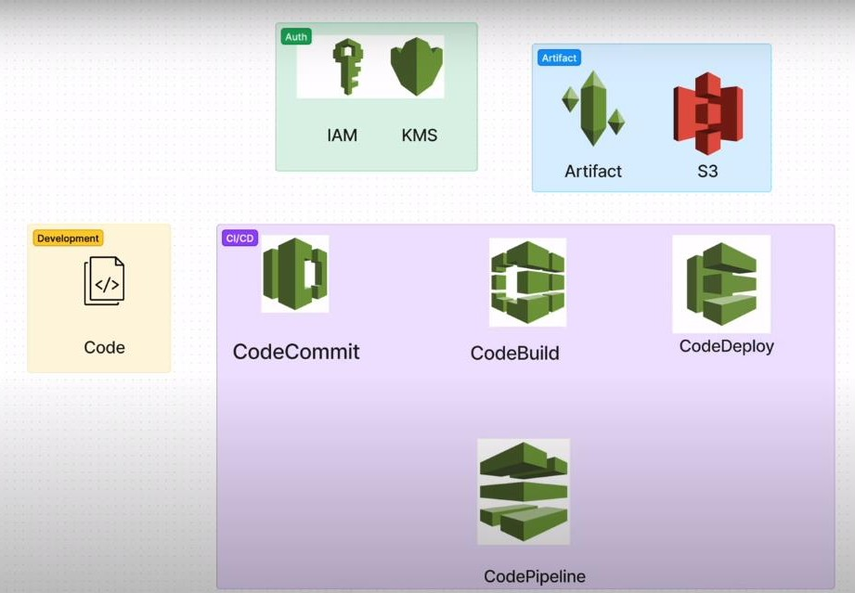

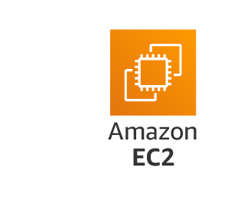

>
CD
>
CI
>
------------------>
Pipeline >
Pipeline
Pipeline
>
>

Slide 4
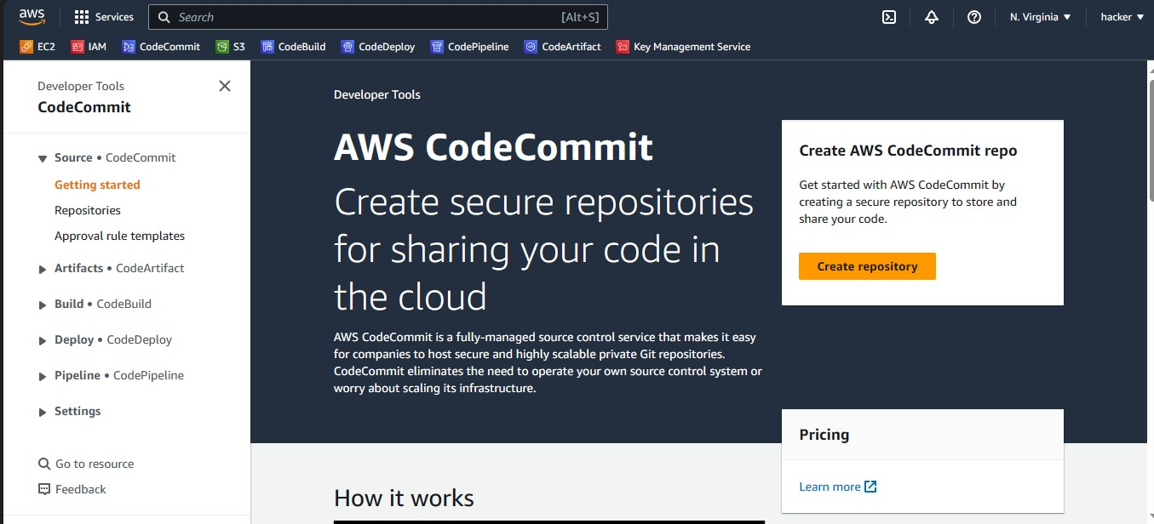
Create Repository from AWS CodeCommit

Slide 5
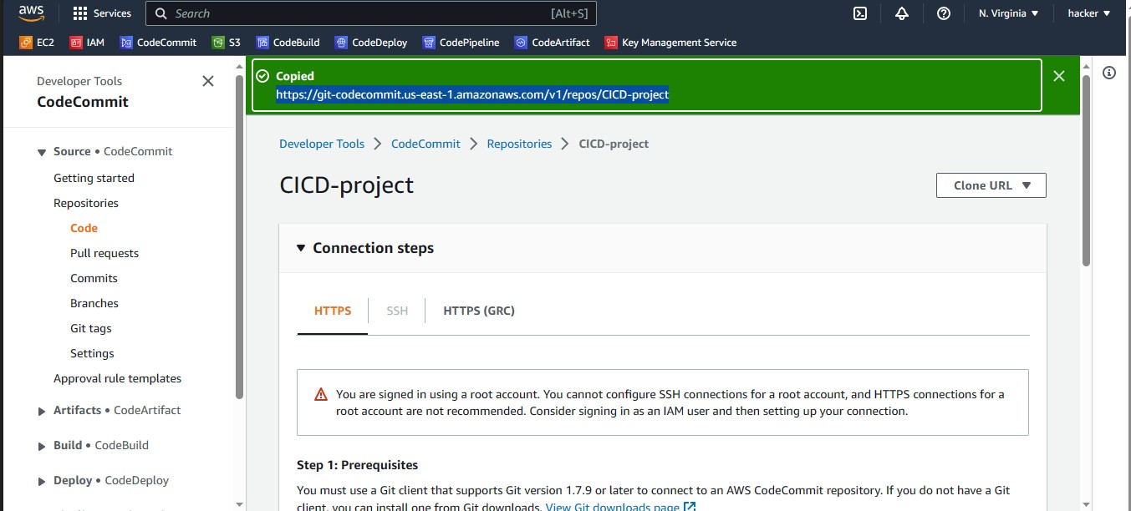

Slide 6
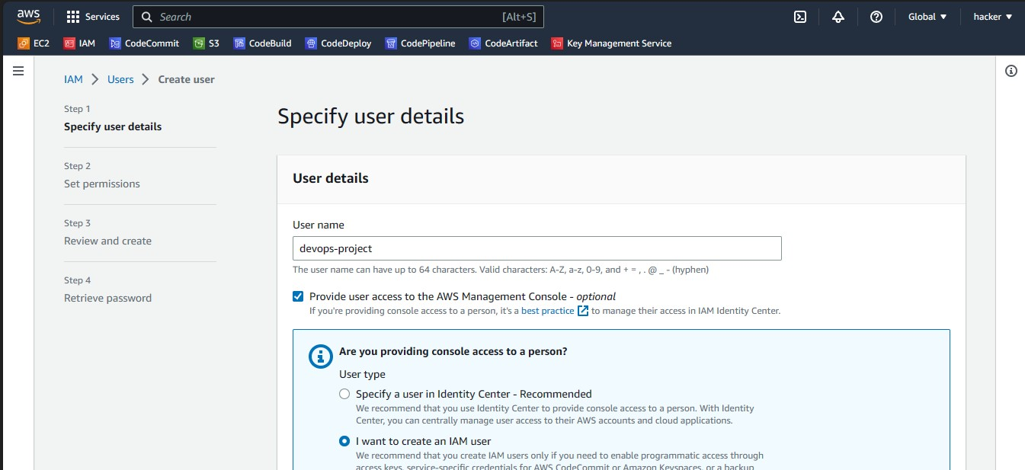
Create IAM User

Slide 7
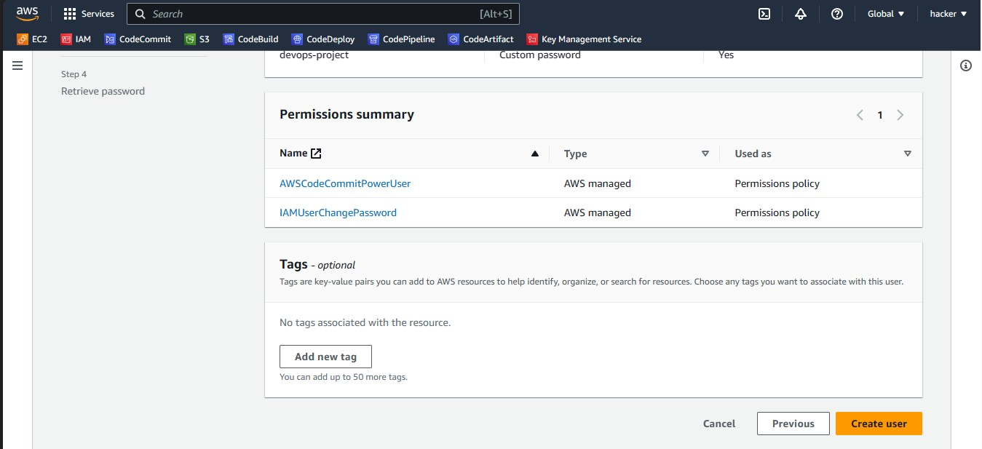
Give Permission PowerUser of AWS CodeCommit

Slide 8
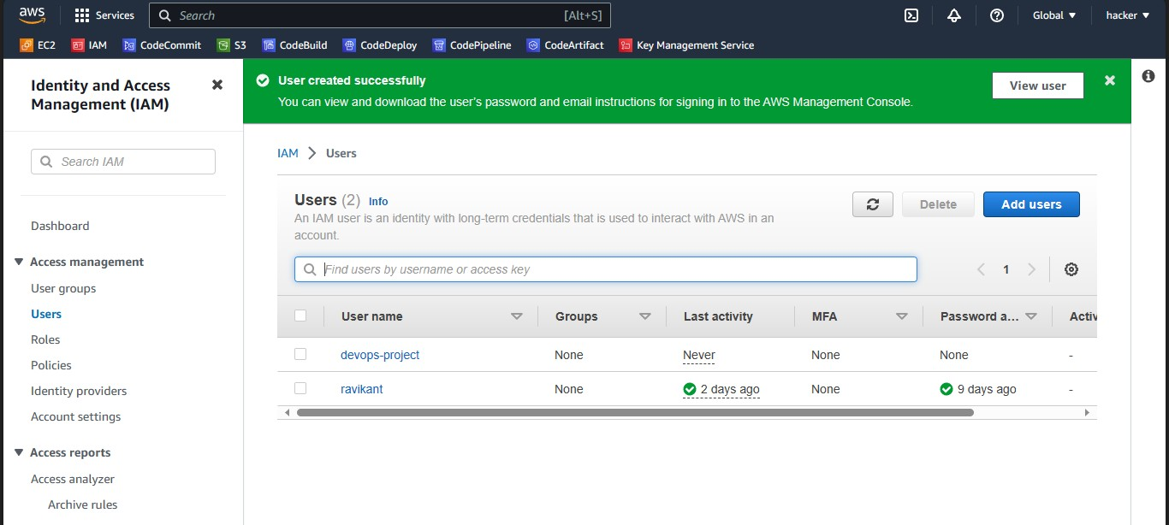

Slide 9
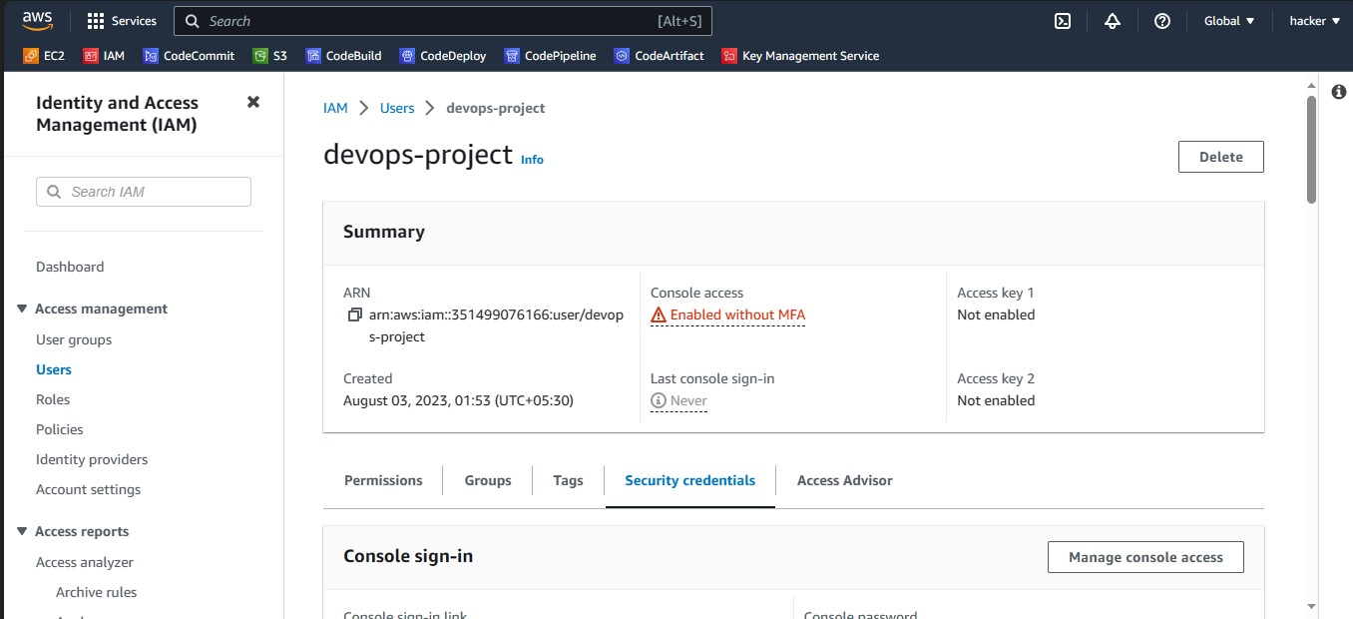

Slide 10
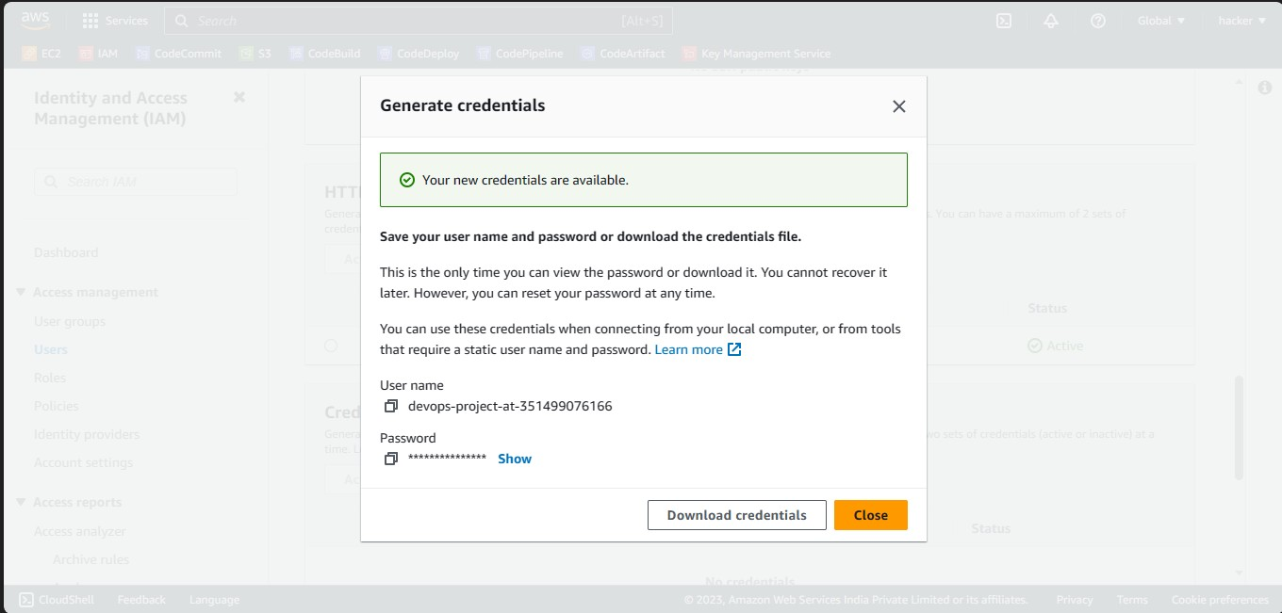

Slide 11
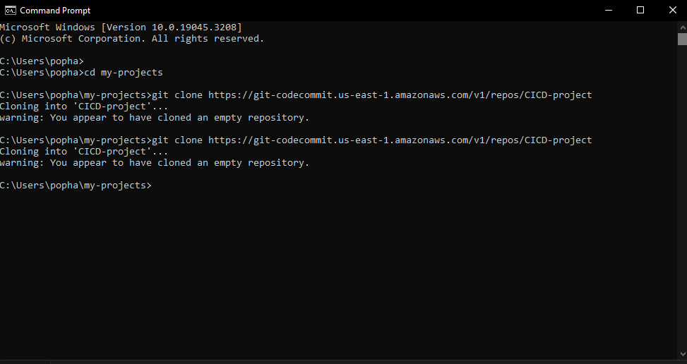

Slide 12
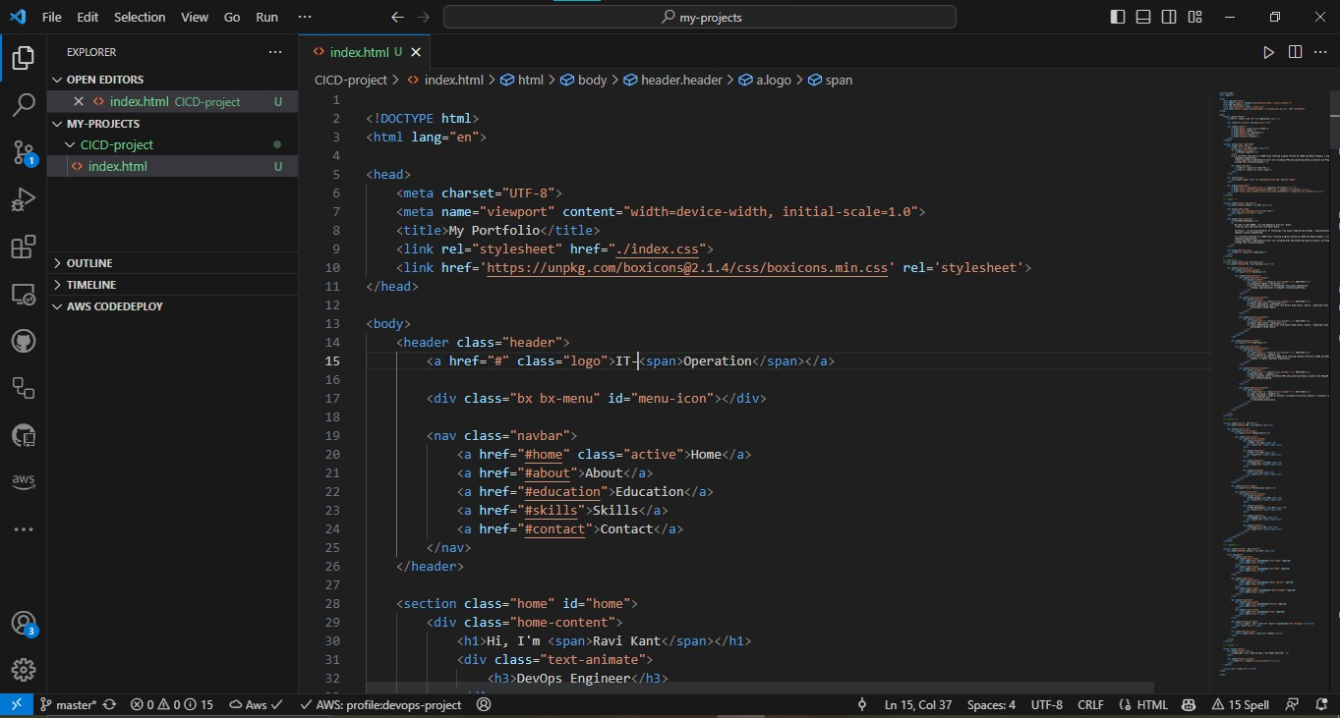

Slide 13
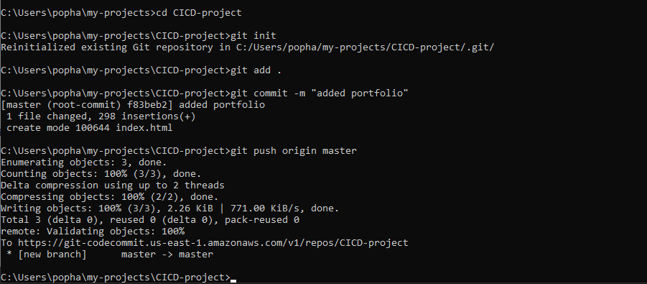

Slide 14
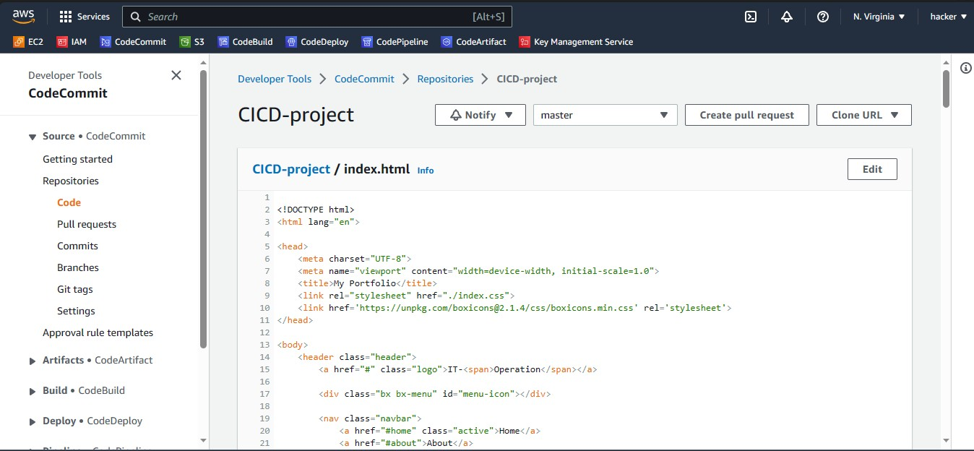

Slide 15
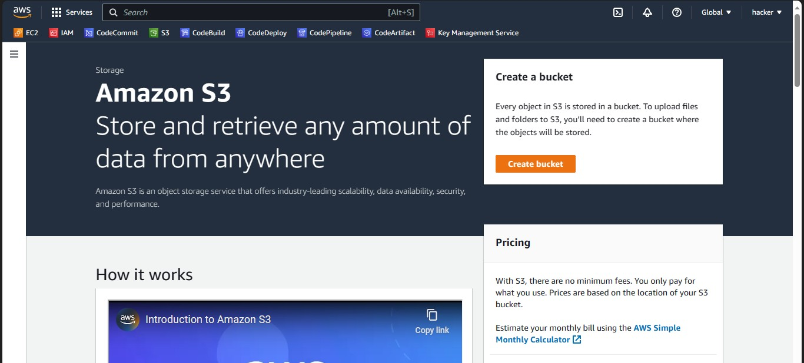
Create Bucket of Amazon S3

Slide 16
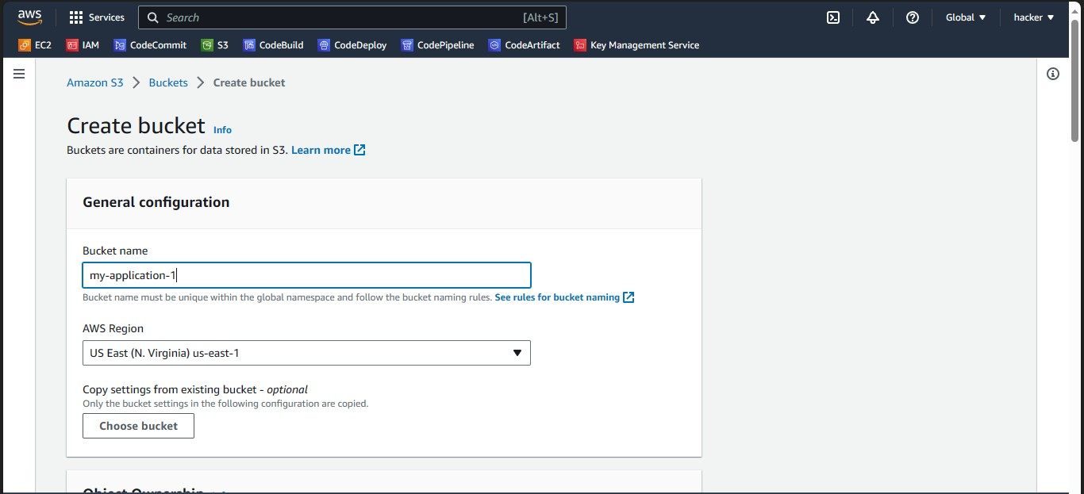

Slide 17
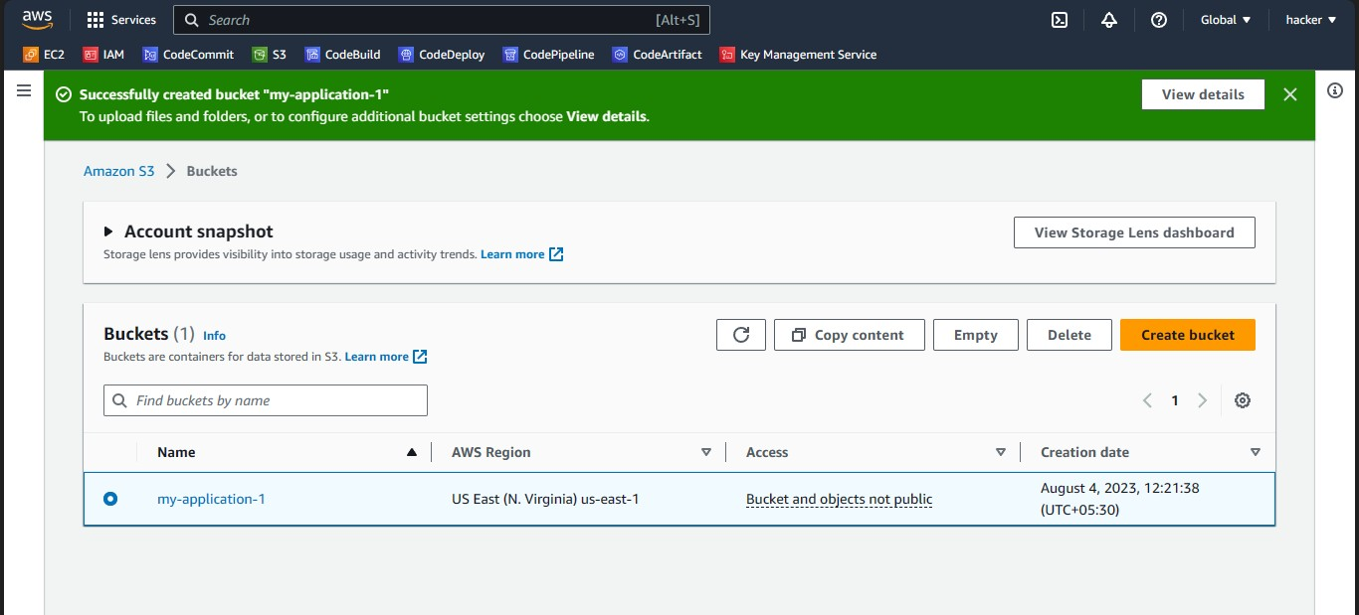

Slide 18
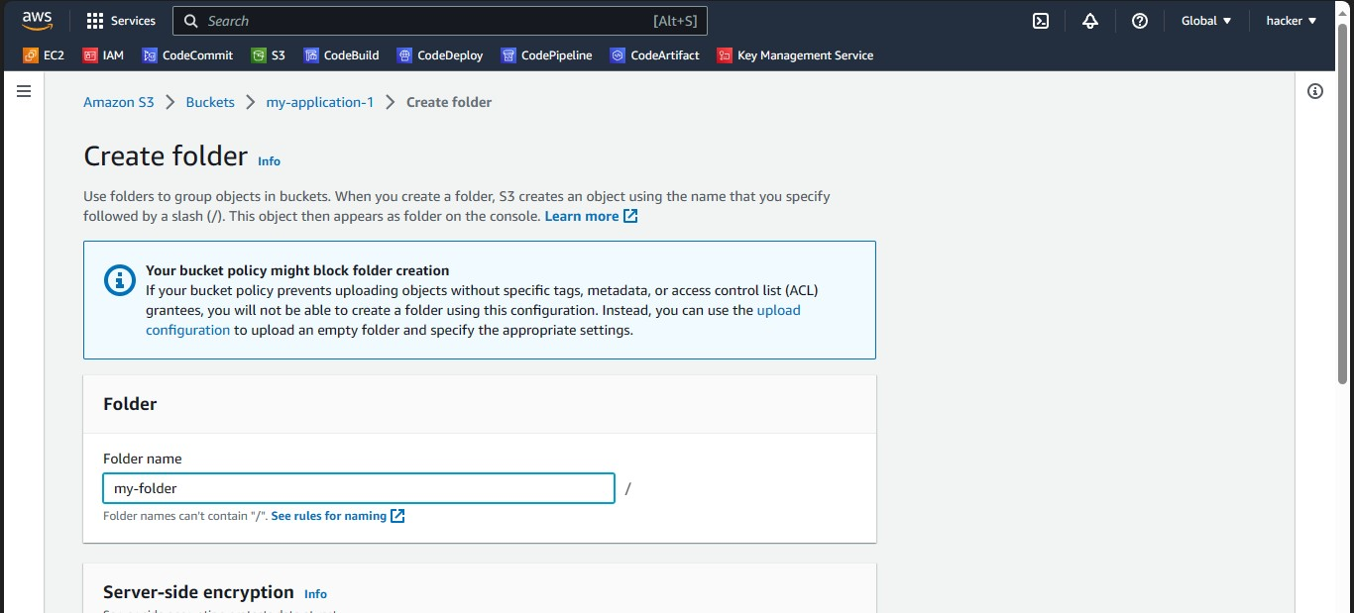

Slide 19
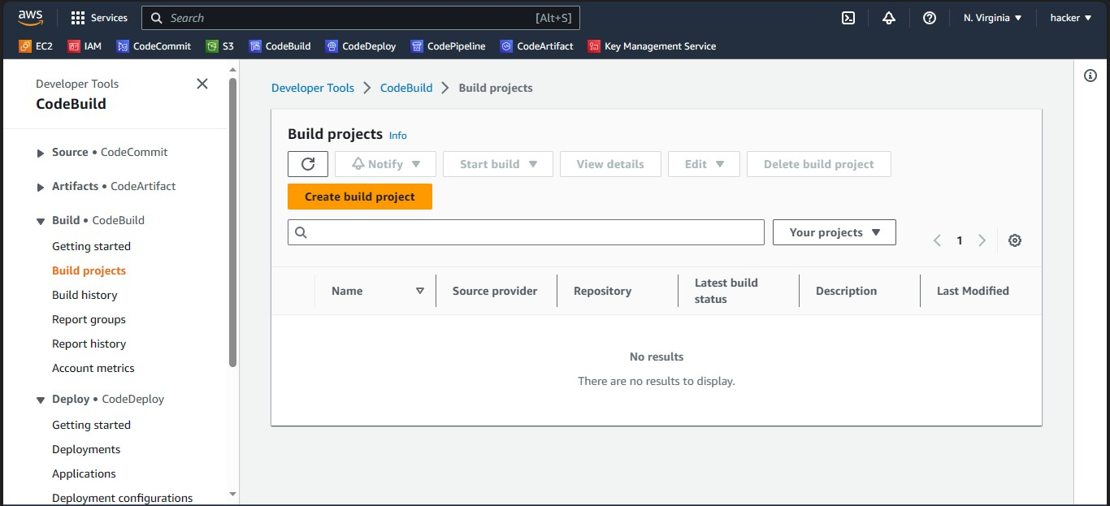
Create Build from AWS CodeBuild

Slide 20
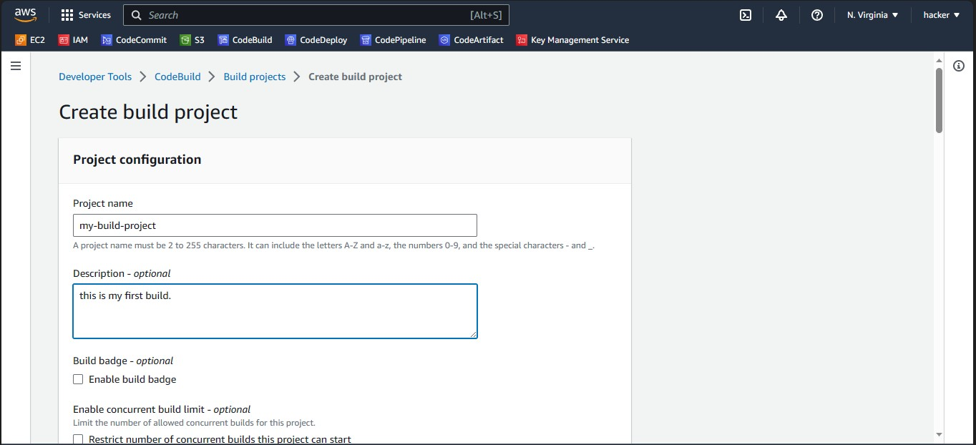

Slide 21
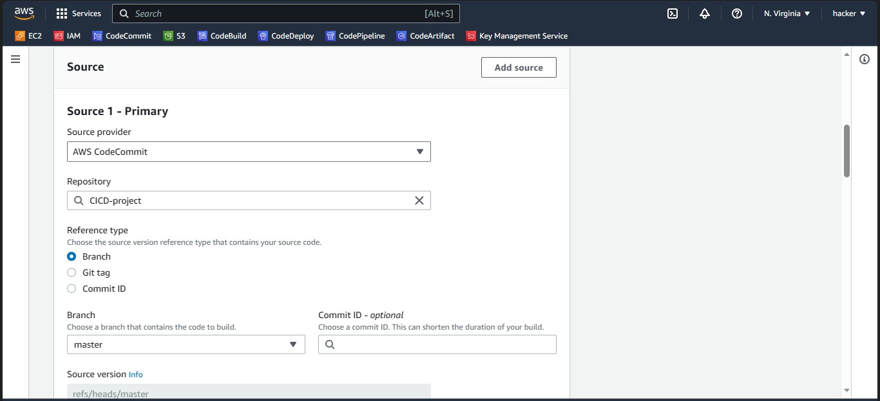

Slide 22
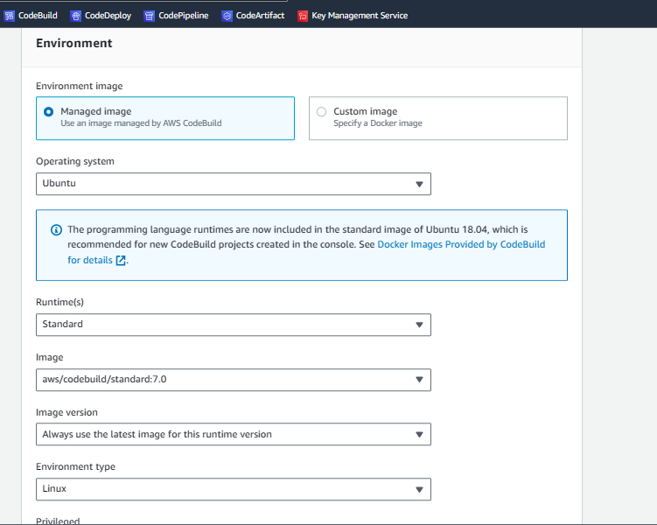

Slide 23
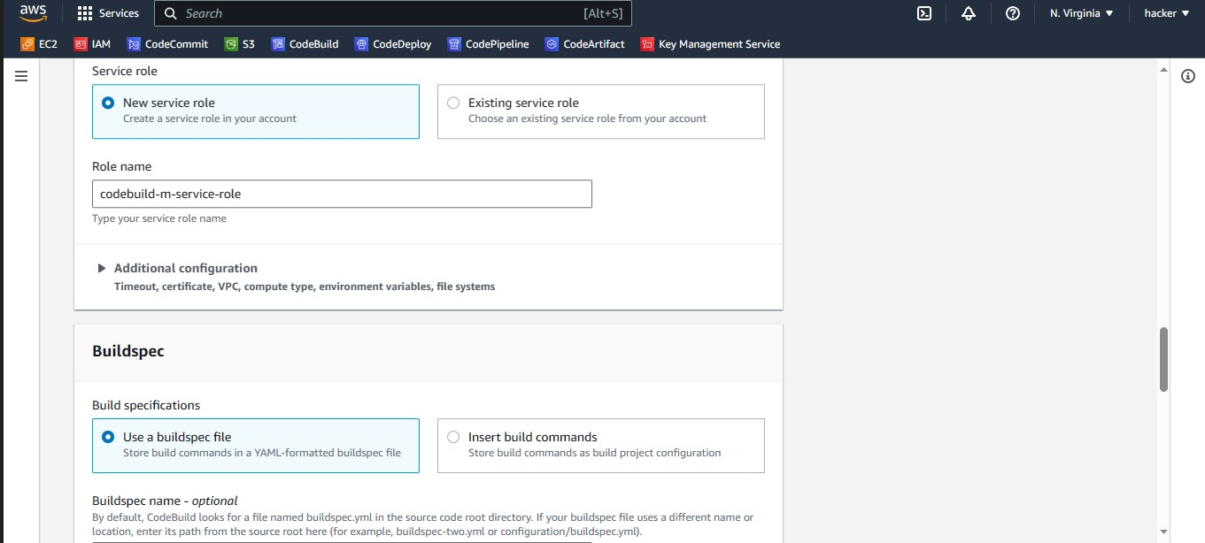

Slide 24
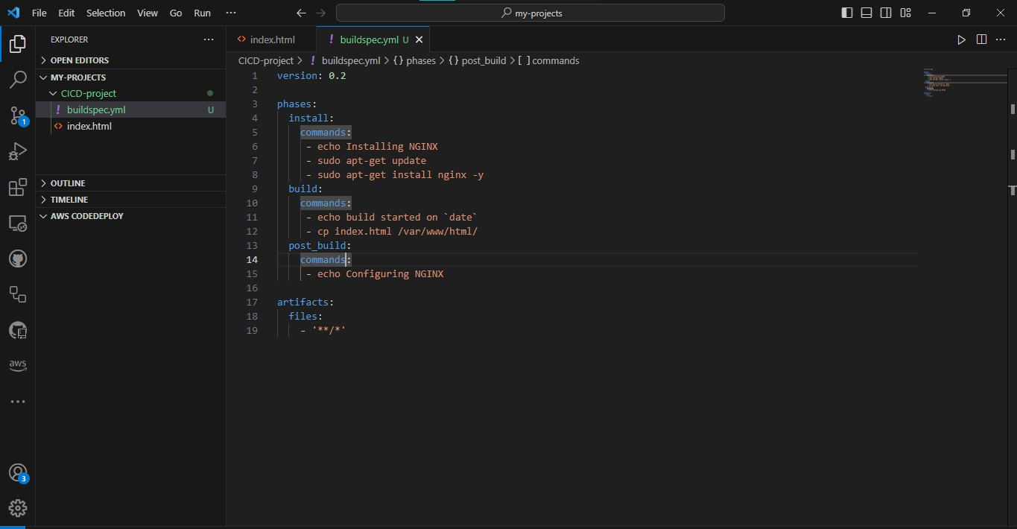

Slide 25
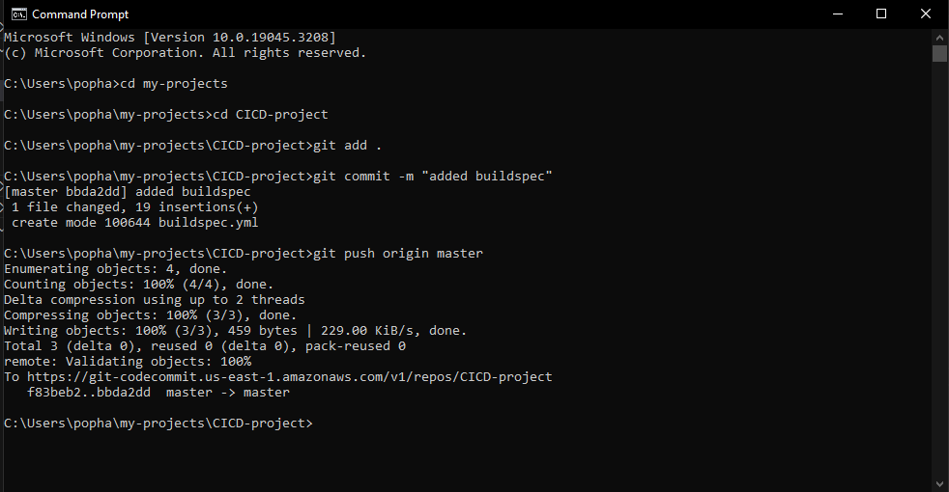

Slide 26
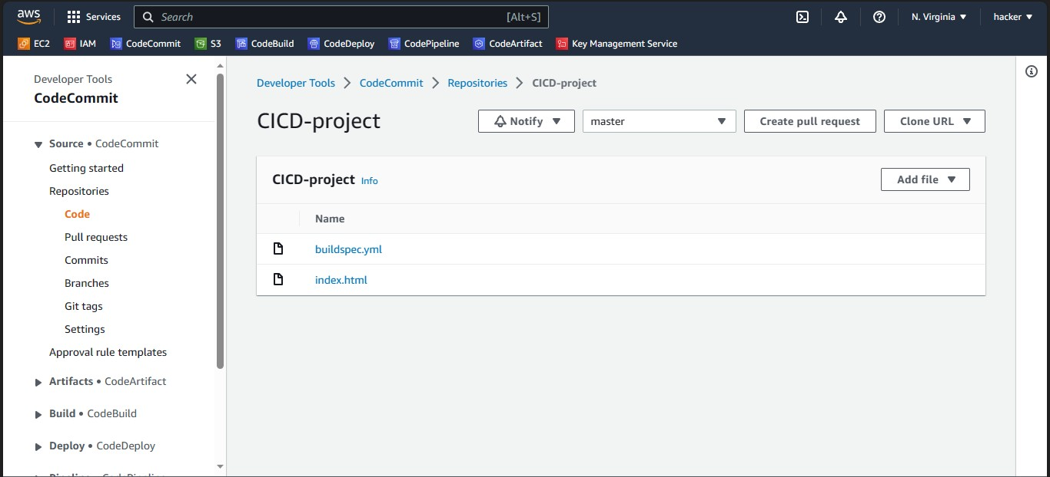

Slide 27
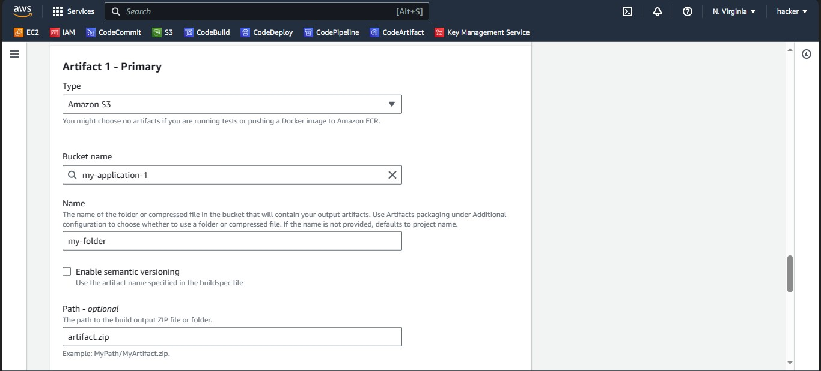

Slide 28
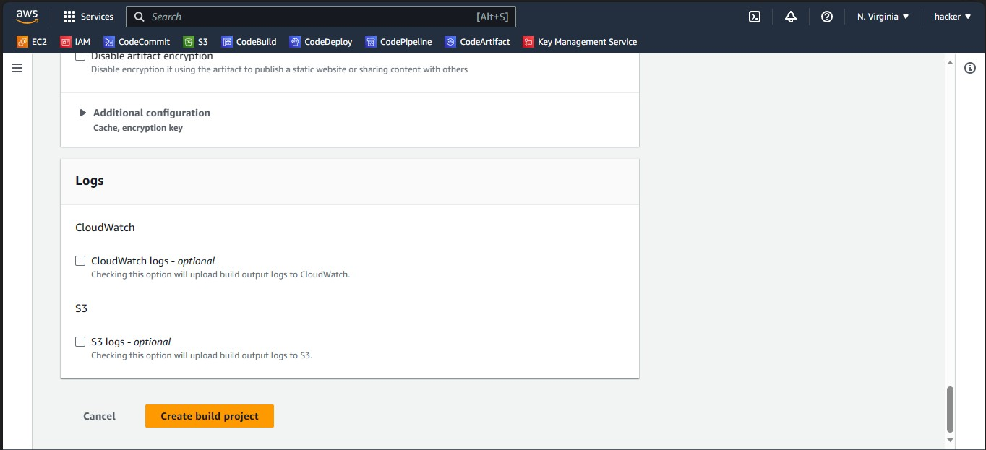

Slide 29
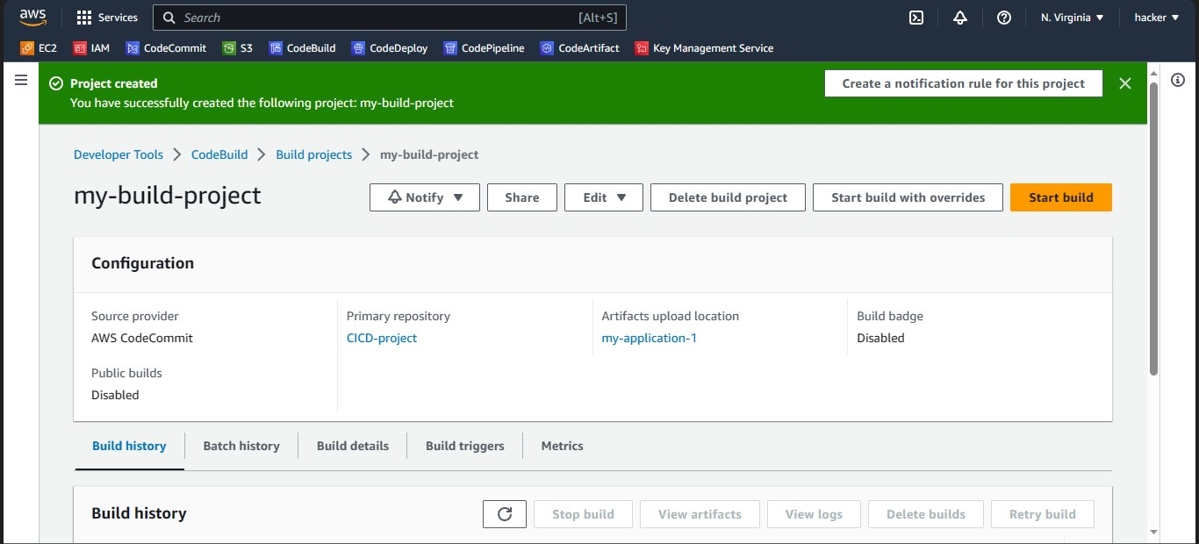

Slide 30
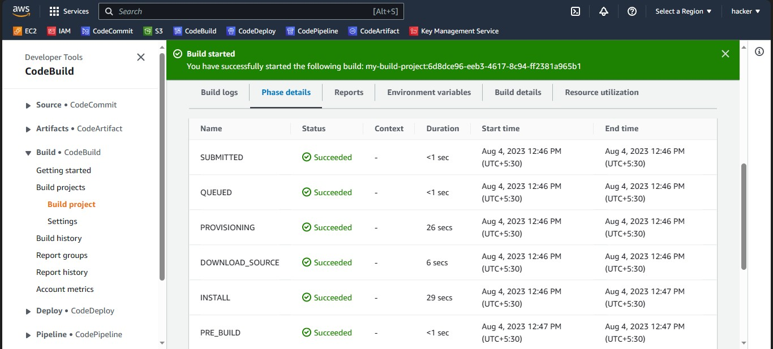

Slide 31
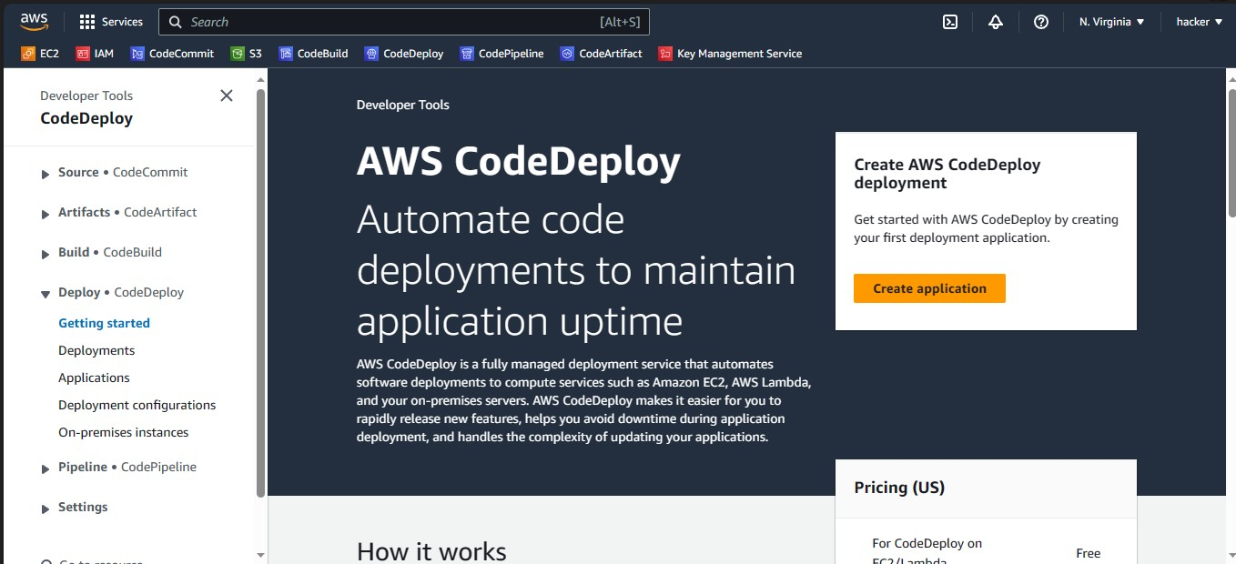
Create Application from AWS CodeDeploy

Slide 32
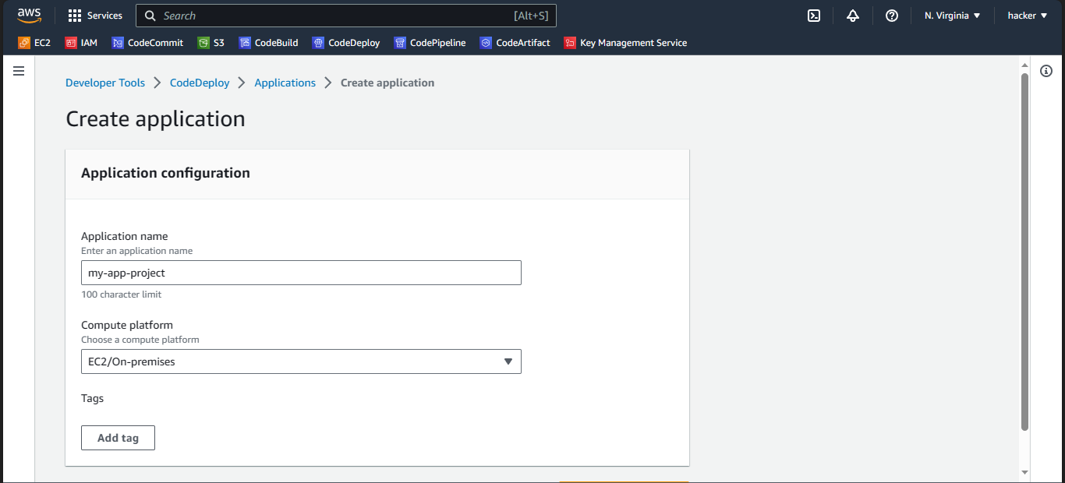

Slide 33
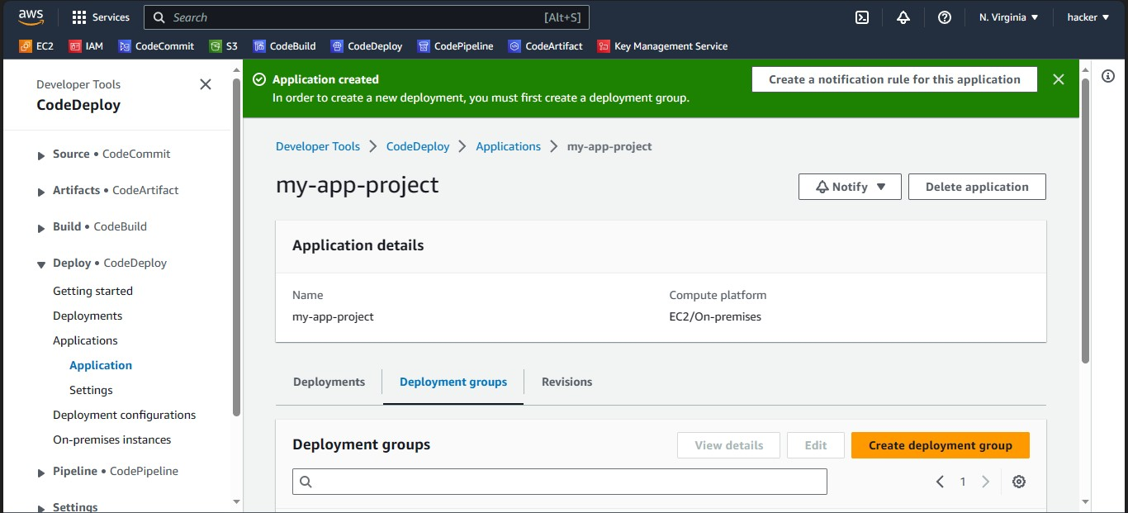

Slide 34
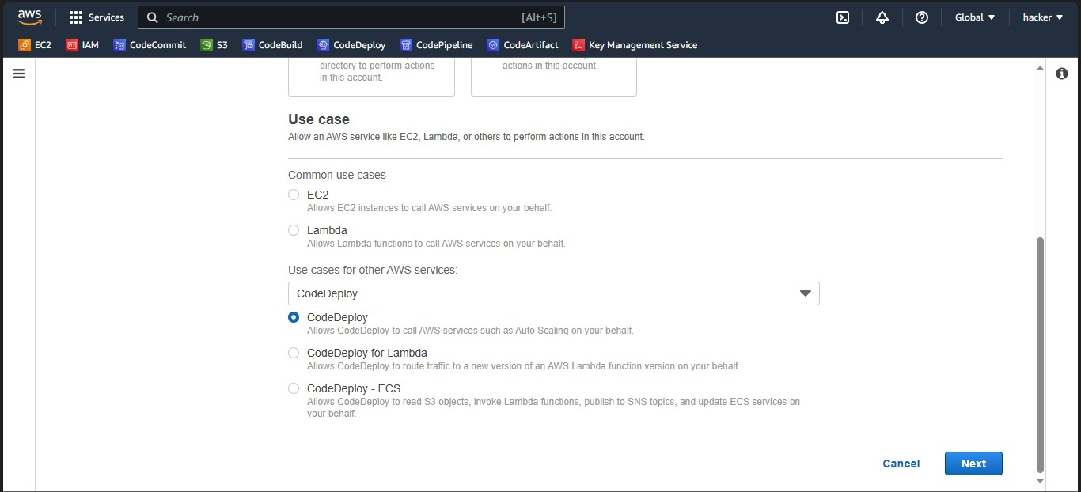
Create Role for CodeDeploy

Slide 35
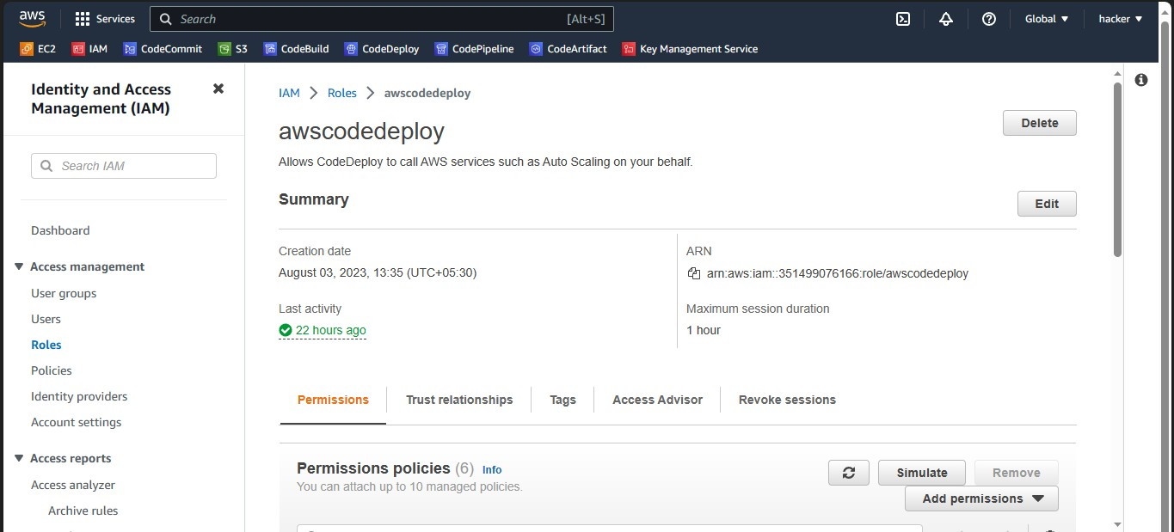

Slide 36
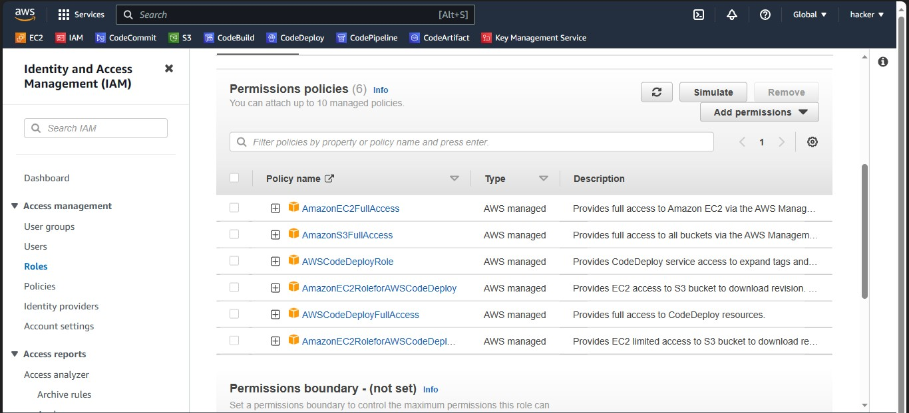

Slide 37
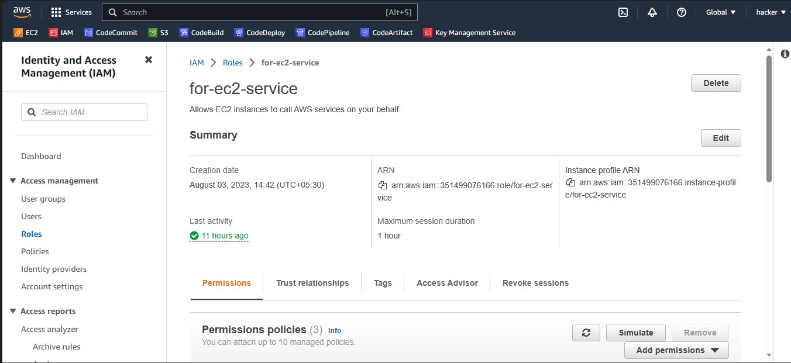
Create Role for Amazon EC2

Slide 38
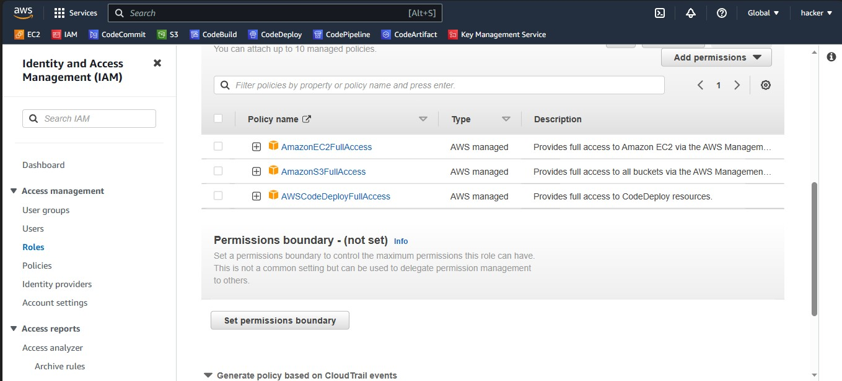

Slide 39
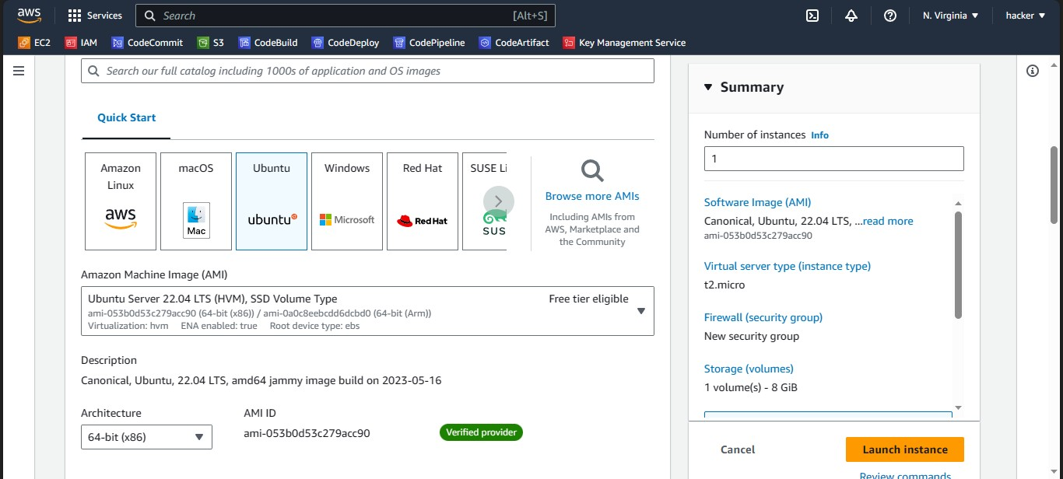
Create Ubuntu Machine

Slide 40
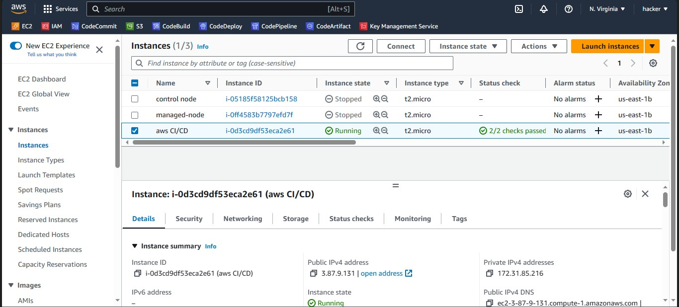

Slide 41
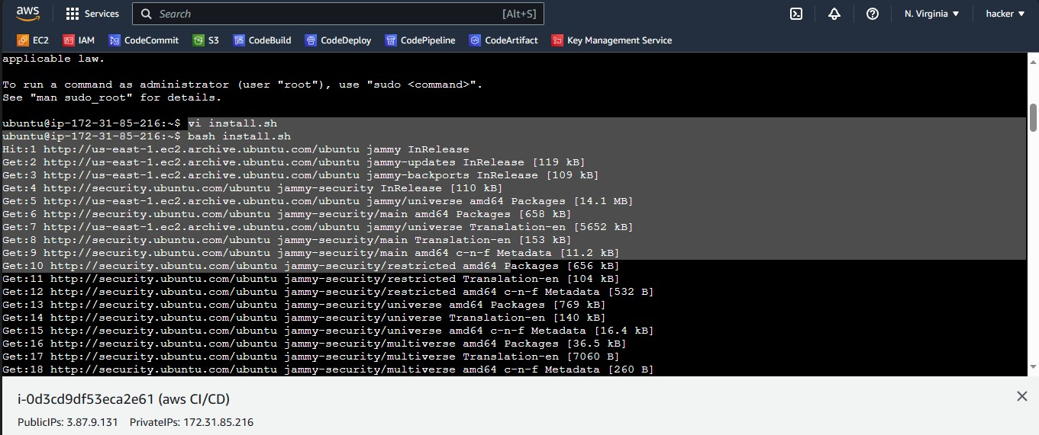

Slide 42
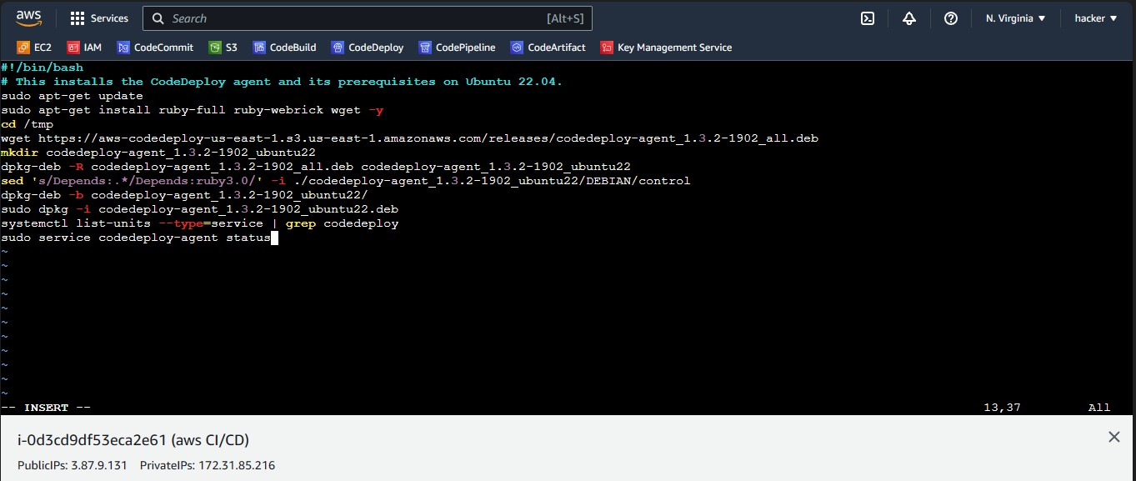

Slide 43
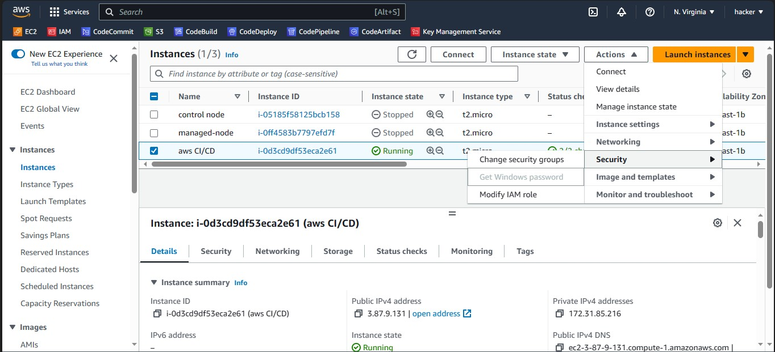

Slide 44
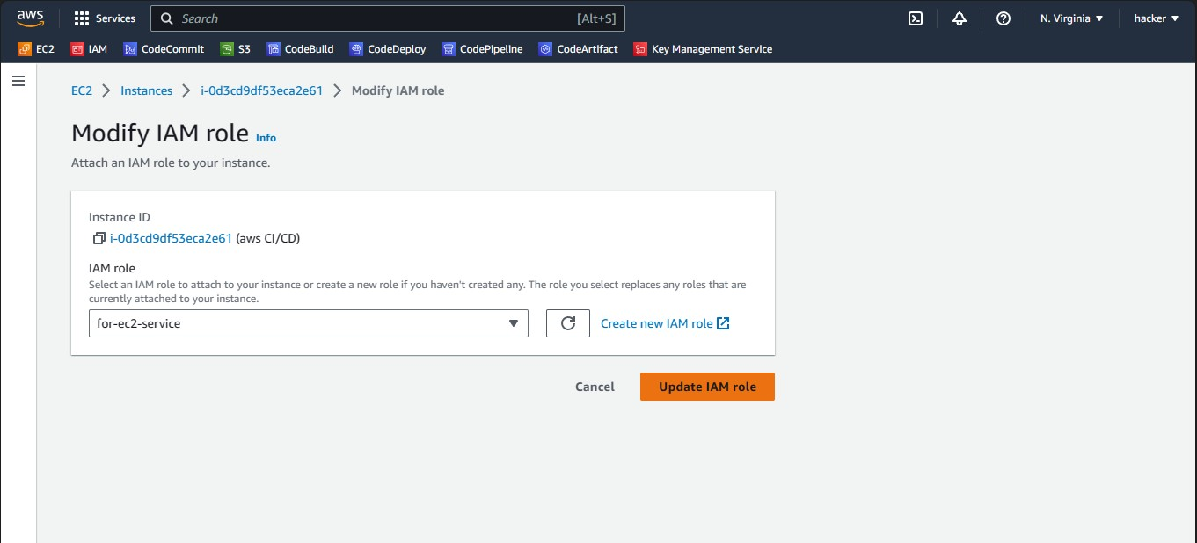

Slide 45
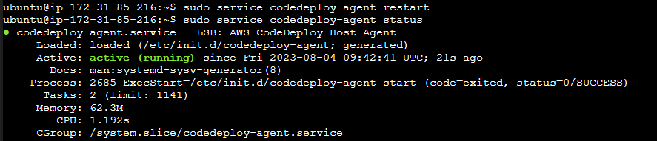

Slide 46
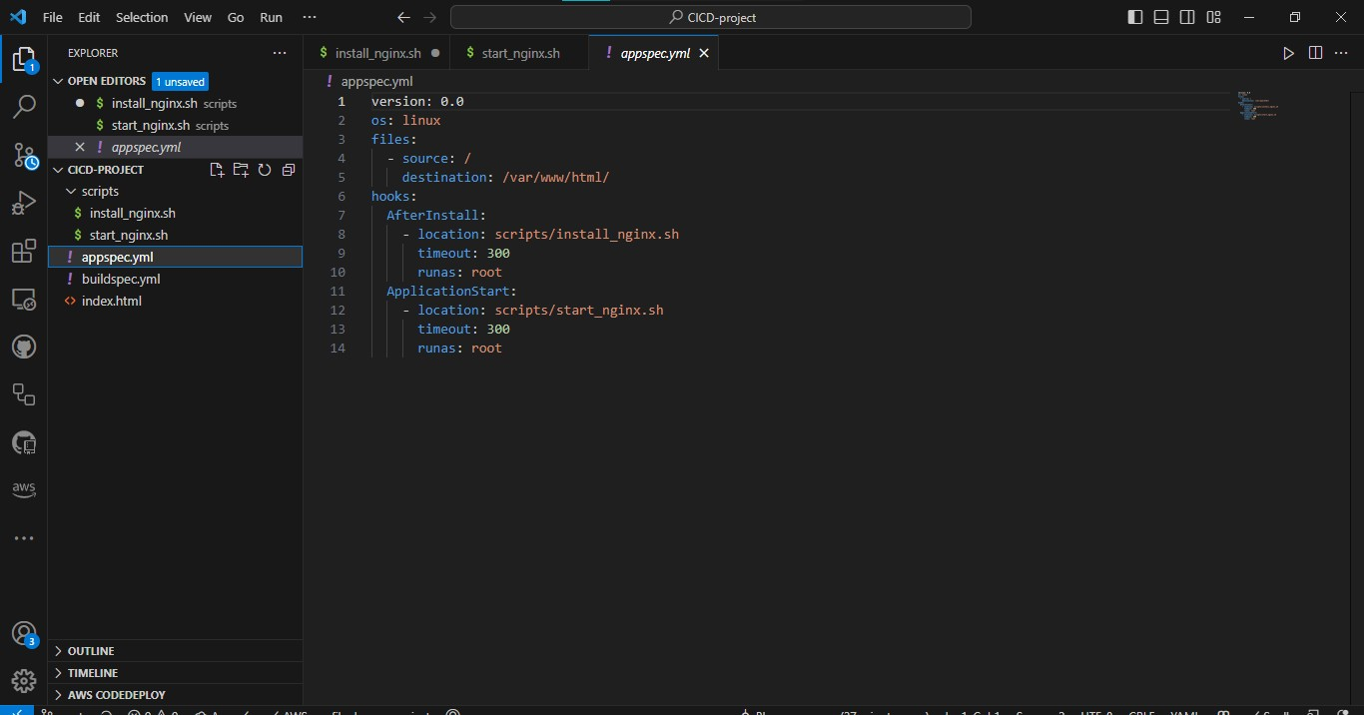
Create appspec.yml file

Slide 47
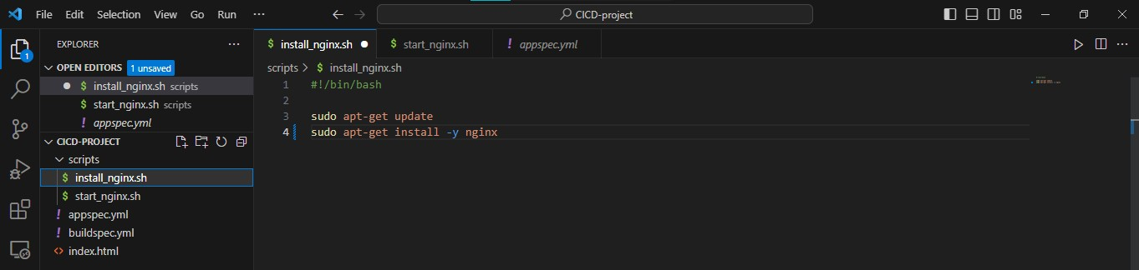
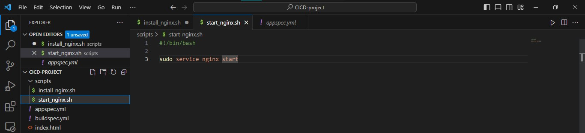

Slide 48
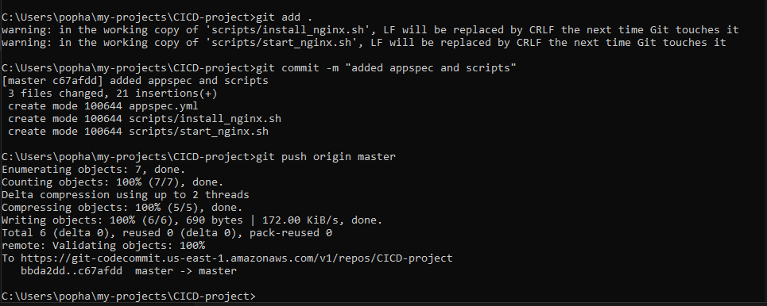

Slide 49
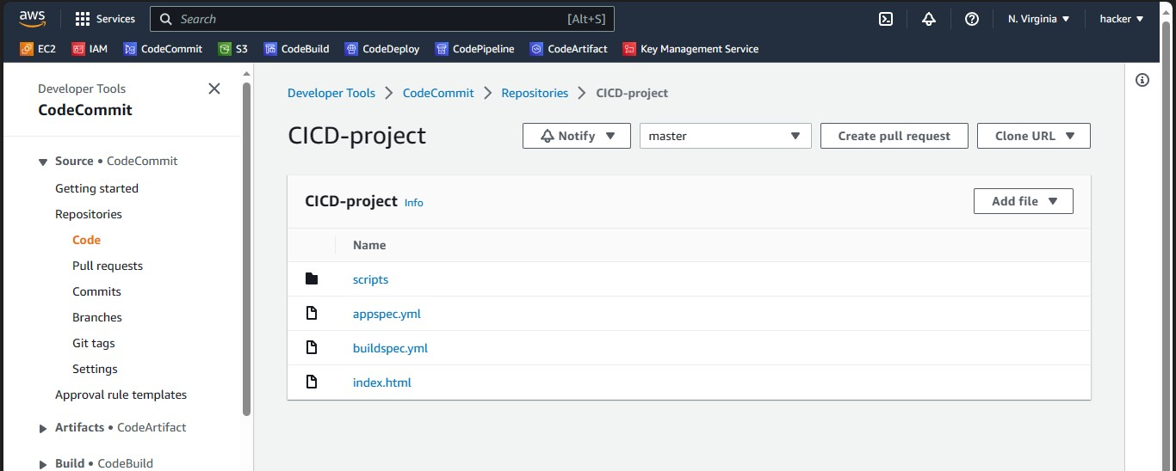

Slide 50


Slide 51

Create Deployment Group from CodeDeploy

Slide 52


Slide 53


Slide 54


Slide 55

Create Deployment from CodeDeploy

Slide 56


Slide 57


Slide 58

It Work..!

Slide 59

Create Pipeline from AWS CodePileline

Slide 60


Slide 61


Slide 62


Slide 63


Slide 64


Slide 65

Some Changes in Code

Slide 66


Slide 67

Release Code in Pipeline

Slide 68

FInally It Work..!

Slide 69


